Slide 1
“HAPPY EATING” Course Code : CSE 402
Presented By
Ananya Karmaker Tusty
Roll No: 16102019
Session:2015-16
Co-Partner
Farjana Yesmin Muna
Roll No:1602017

Slide 2
Problem Statement
“HAPPY EATING” is a web based application.
This application helps the customers to order various foods and drinks from some local restaurant or cafeteria through the use of this website, just by sitting at university hall . And the order is delivered to our university campus.

Slide 3
Purpose
The main aim of the project is to develop a management system like food ordering system in our university.
It automates the existing manual system with the help of advance computerized software.

Slide 4
Existing System…
-There are no facilities in our university to order food from the restaurents.
-Students have to visit hotels to know about the food items and then order and pay.

Slide 5
Proposed Solution
1.Develop login, registration system. Also includes many features .Such as: ordering food etc
2.Timely delivery.
3.Social media friendly.
4. Overcome the disadvantages of the traditional queueing system.
5.Convenience in payments.

Slide 6
Main Module
Our possible outcome has 2 modules:
1.Admin module
2.User module

Slide 7
Software Requirements
Operating System | Windows 7/10
Front End | HTML, Javascript
Back end | CSS, PHP, MySQL
Supporting Server | XAMPP
Editor | Notepad++

Slide 8
Block diagram of the system
customer
web ordering system
Database
Order retrieval
Restaurant employee
customer
customer
Menu management system
Admin

Slide 9
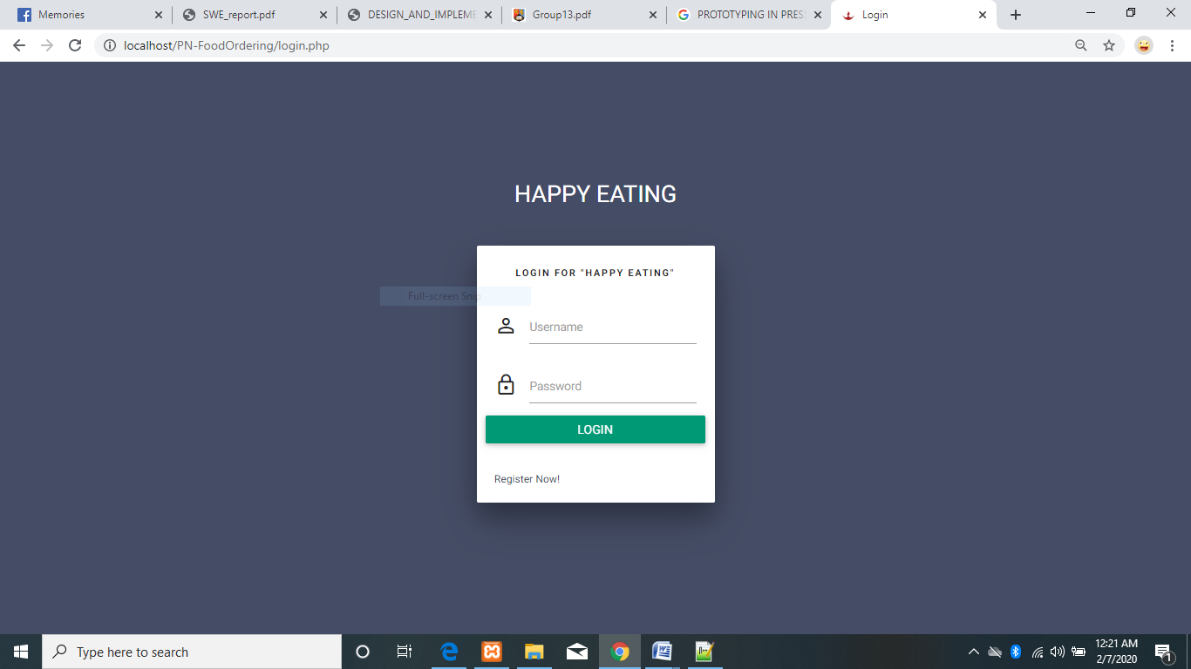
User/Admin Login Form

Slide 10
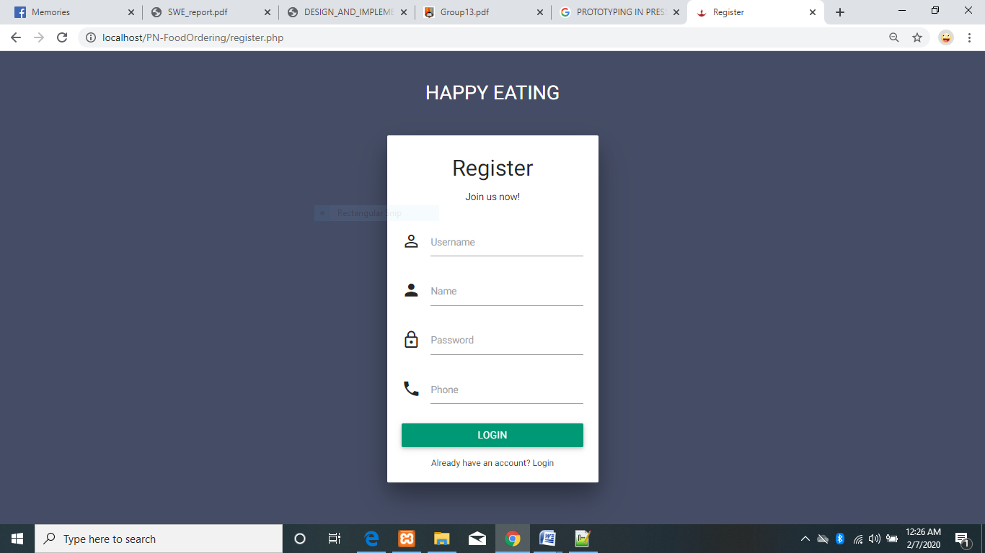
User/Admin Registration form
When any user or admin want to enter this page then they should have to fill up the following form:

Slide 11
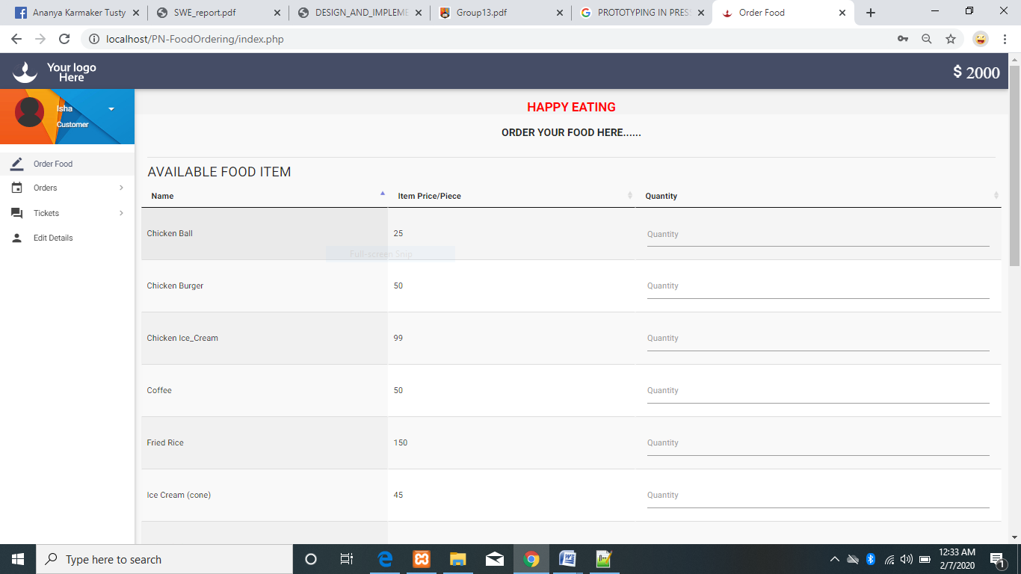
Food Item Page

Slide 12
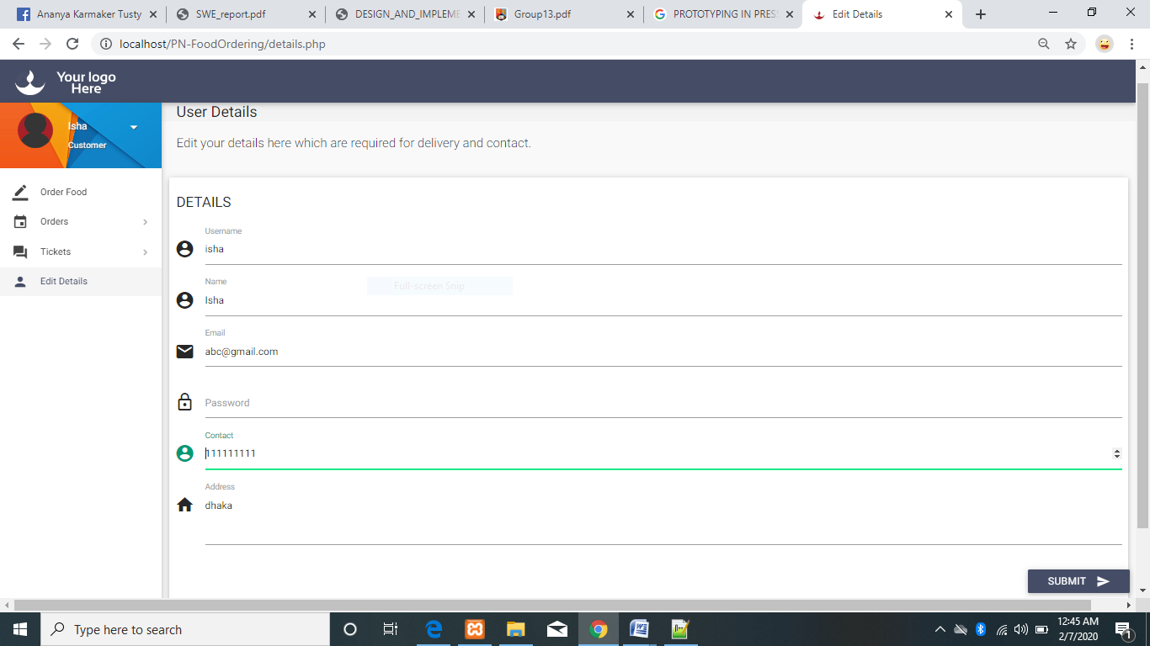
Users Details Page…

Slide 13
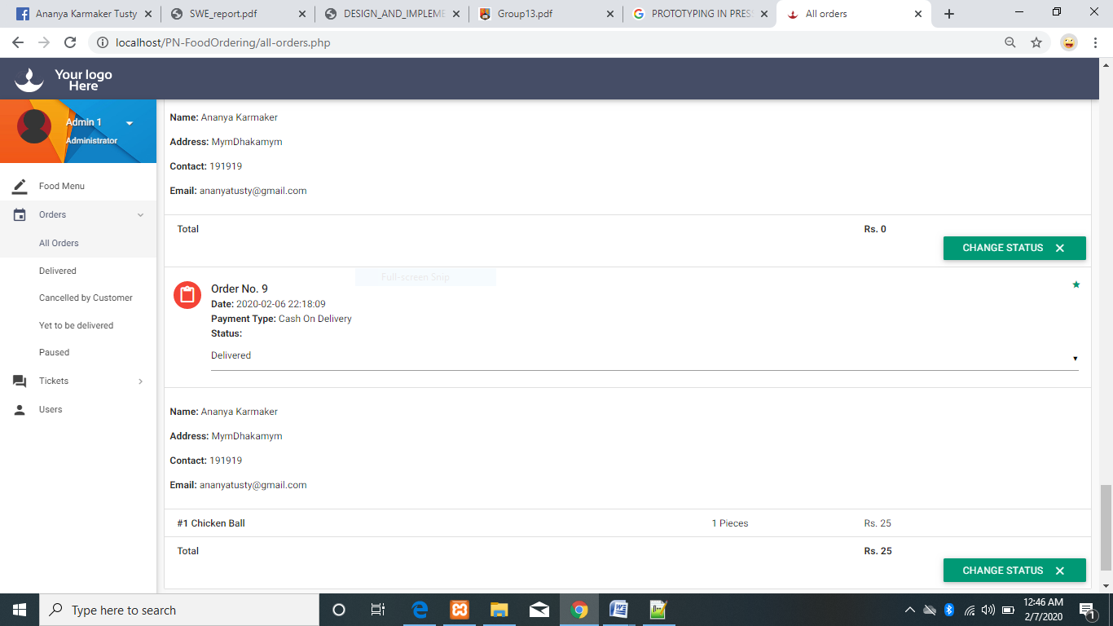
All Orders Page

Slide 14
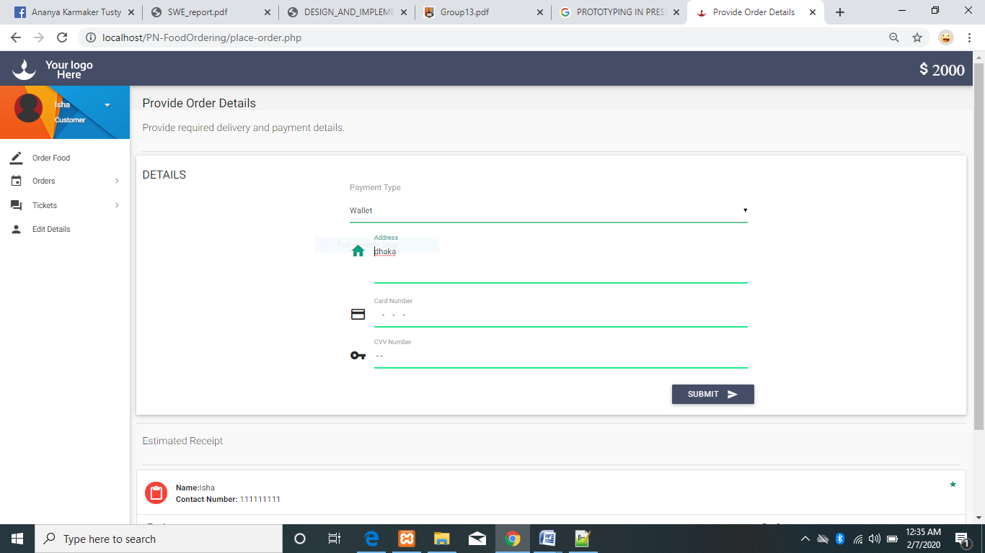
Provide Order Details Page

Slide 15
Conclusions
By using this application customers do not have to travel any restaurant just for ordering food.
Benefits both the customer and the business.

Slide 16
Thank You

